Slide 1


Slide 12
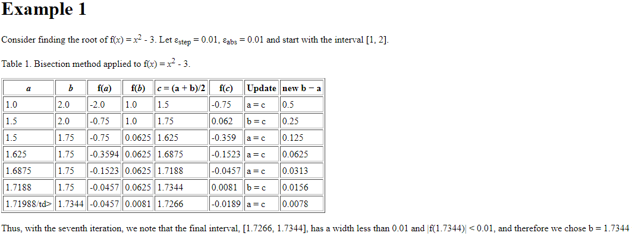
Examples on different numerical methods to find roots.
1- Bisection method:

Slide 13
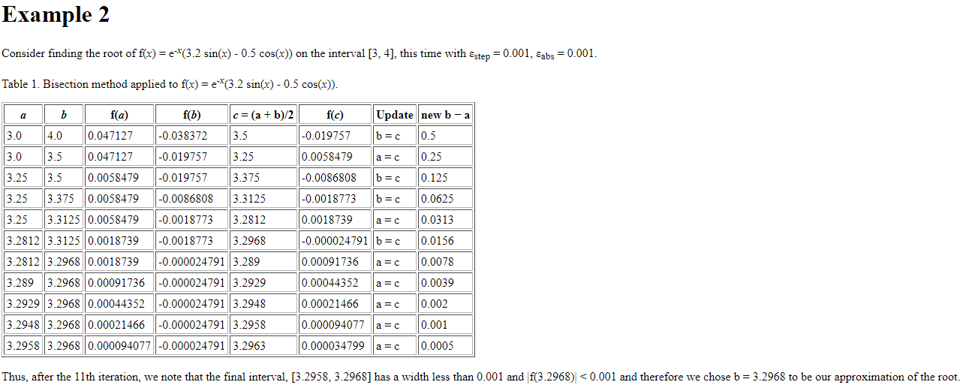

Slide 14
Examples on Fixed point method

Slide 15
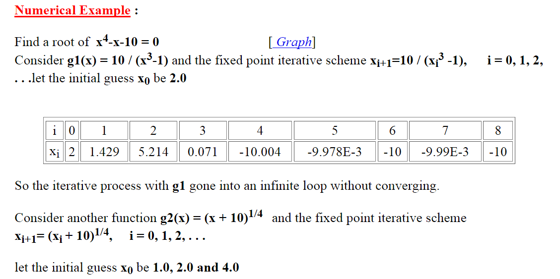


Slide 16
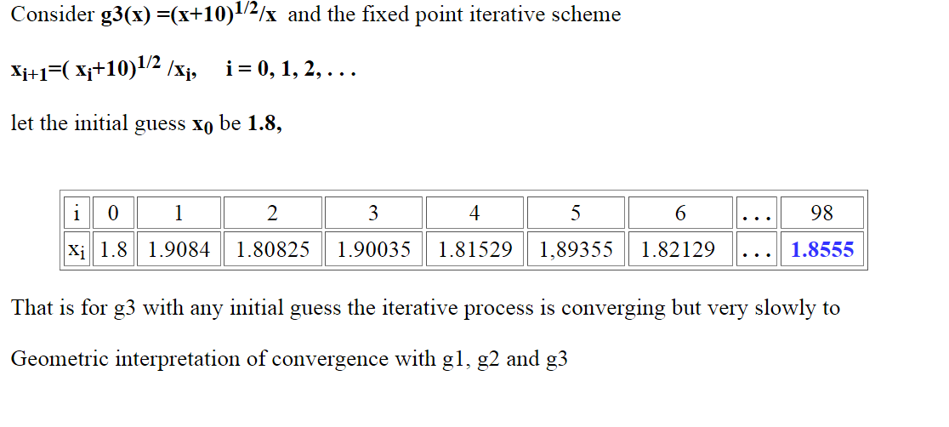

Slide 17
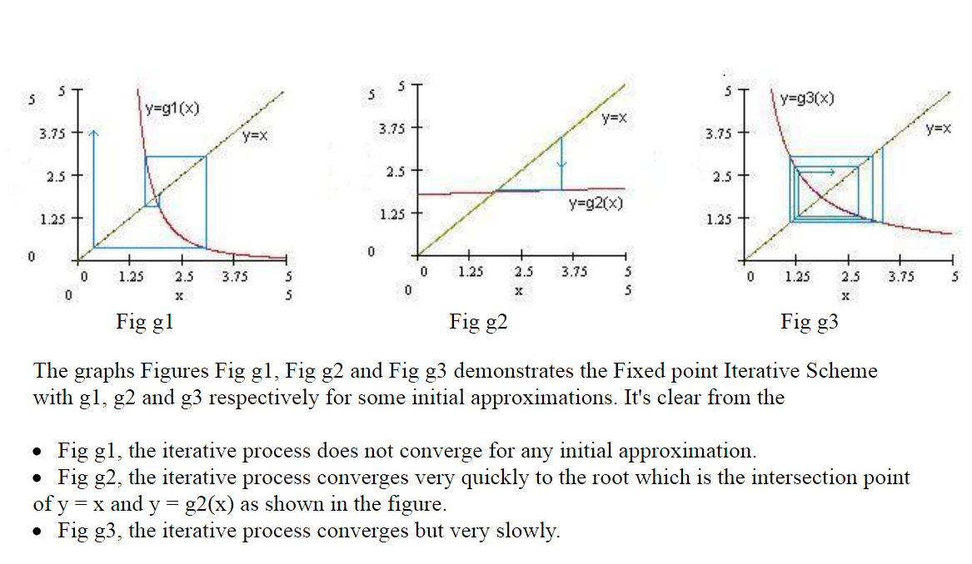

Slide 18
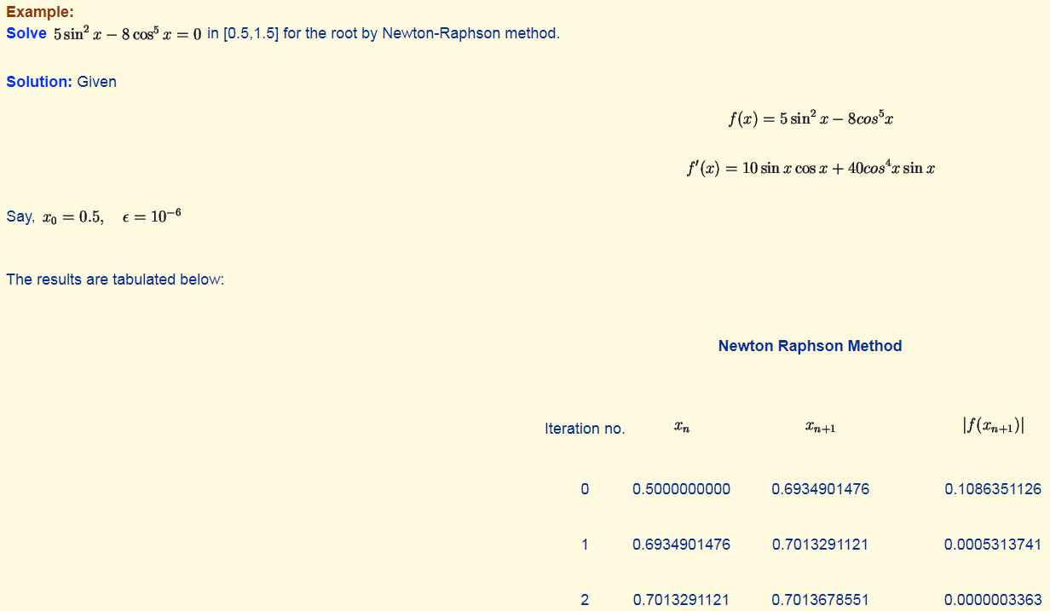
Examples on Newton’s Raphson Method:

Slide 19



